Slide 1
Interpretable Machine Learning
A Guide for Making Black Box Models Explainable

Slide 2
Summary
Machine learning has great potential for improving products, processes and research. But computers usually do not explain their predictions which is a barrier to the adoption of machine learning. This book is about making machine learning models and their decisions interpretable.

Slide 3
Summary
After exploring the concepts of interpretability
interpretable models such as decision trees, decision rules and linear regression
model-agnostic methods for interpreting black box models such as feature importance and accumulated local effects, and explaining individual predictions with Shapley values and LIME
the book presents methods specific to deep neural networks

Slide 4
Summary
All interpretation methods are explained in depth and discussed critically. How do they work under the hood? What are their strengths and weaknesses? How can their outputs be interpreted? This book will enable you to select and correctly apply the interpretation method that is most suitable for your machine learning project. Reading the book is recommended for machine learning practitioners, data scientists, statisticians, and anyone else interested in making machine learning models interpretable.

Slide 5
Chapter 1 Preface by the Author
This book covers many techniques of interpretable machine learning.
In the first chapters, I introduce the concept of interpretability and motivate why interpretability is necessary. The book discusses the different properties of explanations and what humans think is a good explanation. Then we will discuss machine learning models that are inherently interpretable, for example regression models and decision trees.
The main focus of this book is on model-agnostic interpretability methods. Model-agnostic means that these methods can be applied to any machine learning model and are applied after the model has been trained. This independence from the model makes model-agnostic methods very flexible and powerful.

Slide 6
model-agnostic
Some techniques explain how individual predictions were made, like local interpretable model-agnostic explanations (LIME) and Shapley values.
Other techniques describe the average behavior of the model across a dataset. Here we learn about the partial dependence plot, accumulated local effects, permutation feature importance and many other methods.
A special category is example-based methods that produce data points as explanations. Counterfactual explanations, prototypes, influential instances and adversarial examples are example-based methods, which are discussed in this book.

Slide 7
Structure of the chapters
The first paragraph summarizes the method.
Then I try to explain the method intuitively without relying on mathematical formulas.
Then we look at the theory of the method to get a deep understanding of how it works.
Each method is applied to real data and contains critical discussions about advantages and disadvantages of the respective interpretation method.
In the last section of each chapter, available software implementations are discussed.

Slide 8
It is often crucial that machine learning models are interpretable. Interpretability helps developers with debugging and improvements, builds trust in the model, justifies model predictions and leads to new insights.
The increased need for machine learning interpretability is a natural consequence of an increased use of machine learning.

Slide 9
Chapter 2 Introduction
This book explains to you how to make (supervised) machine learning models interpretable.
This book explains to you how to make (supervised) machine learning models interpretable.
you will not find the most novel and fancy methods in this book, but established methods and basic concepts of machine learning interpretability.

Slide 10
Chapter 2 Introduction
This book starts with some (dystopian) short stories that are not needed to understand the book, but hopefully will entertain and make you think.
Then the book explores the concepts of machine learning interpretability. We will discuss when interpretability is important and the different types of explanations that exist.
Terms used throughout the book can be looked up in the Terminology chapter.
Most of the models and methods explained are presented using real data examples which are described in the Data chapter.
One way to make machine learning interpretable is to use interpretable models, such as linear models or decision trees.
The other option is the use of model-agnostic interpretation tools that can be applied to any supervised machine learning model.
Model-agnostic methods can be divided into global methods that describe the average behavior of the model, and local methods that explain individual predictions.
The Model-Agnostic Methods chapter deals with methods such as partial dependence plots and feature importance. Model-agnostic methods work by changing the input of the machine learning model and measuring changes in the prediction output.
The book ends with an optimistic outlook on what the future of interpretable machine learning might look like.

Slide 11
2.2 What Is Machine Learning?
Machine learning is a set of methods that computers use to make and improve predictions or behaviors based on data.
The book focuses on supervised machine learning, which covers all prediction problems where we have a dataset for which we already know the outcome of interest (e.g. past house prices) and want to learn to predict the outcome for new data.
Excluded from supervised learning are for example clustering tasks (= unsupervised learning) where we do not have a specific outcome of interest, but want to find clusters of data points.
Also excluded are things like reinforcement learning, where an agent learns to optimize a certain reward by acting in an environment (e.g. a computer playing Tetris).

Slide 12
supervised learning
The goal of supervised learning is to learn a predictive model that maps features of the data (e.g. house size, location, floor type, …) to an output (e.g. house price).
If the output is categorical, the task is called classification
if it is numerical, it is called regression.
The machine learning algorithm learns a model by estimating parameters (like weights) or learning structures (like trees).
The algorithm is guided by a score or loss function that is minimized.
A fully trained machine learning model can then be used to make predictions for new instances.

Slide 13
supervised learning
Step 1: Data collection. The more, the better. The data must contain the outcome you want to predict and additional information from which to make the prediction. For a street sign detector (“Is there a street sign in the image?”), you would collect street images and label whether a street sign is visible or not. For a credit default predictor, you need past data on actual loans, information on whether the customers were in default with their loans, and data that will help you make predictions, such as income, past credit defaults, and so on. For an automatic house value estimator program, you could collect data from past house sales and information about the real estate such as size, location, and so on.
Step 2: Enter this information into a machine learning algorithm that generates a sign detector model, a credit rating model or a house value estimator.
Step 3: Use model with new data. Integrate the model into a product or process, such as a self-driving car, a credit application process or a real estate marketplace website.

Slide 14
Performance vs interpretability
Machines surpass humans in many tasks, such as playing chess (or more recently Go) or predicting the weather. Even if the machine is as good as a human or a bit worse at a task, there remain great advantages in terms of speed, reproducibility and scaling. A once implemented machine learning model can complete a task much faster than humans, reliably delivers consistent results and can be copied infinitely. Replicating a machine learning model on another machine is fast and cheap. The training of a human for a task can take decades (especially when they are young) and is very costly.
A major disadvantage of using machine learning is that insights about the data and the task the machine solves is hidden in increasingly complex models. If you focus only on performance, you will automatically get more and more opaque models.

Slide 15
2.3 Terminology
An Algorithm is a set of rules that a machine follows to achieve a particular goal². An algorithm can be considered as a recipe that defines the inputs, the output and all the steps needed to get from the inputs to the output. Cooking recipes are algorithms where the ingredients are the inputs, the cooked food is the output, and the preparation and cooking steps are the algorithm instructions.

Slide 16
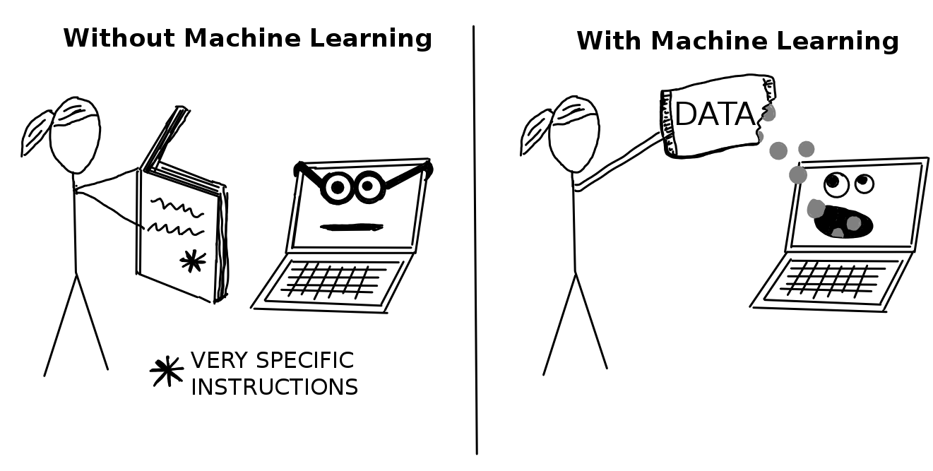
Machine Learning
Machine Learning is a set of methods that allow computers to learn from data to make and improve predictions (for example cancer, weekly sales, credit default). Machine learning is a paradigm shift from “normal programming” where all instructions must be explicitly given to the computer to “indirect programming” that takes place through providing data.

Slide 17
A Learner or Machine Learning Algorithm
A Learner or Machine Learning Algorithm is the program used to learn a machine learning model from data. Another name is “inducer” (e.g. “tree inducer”).

Slide 18
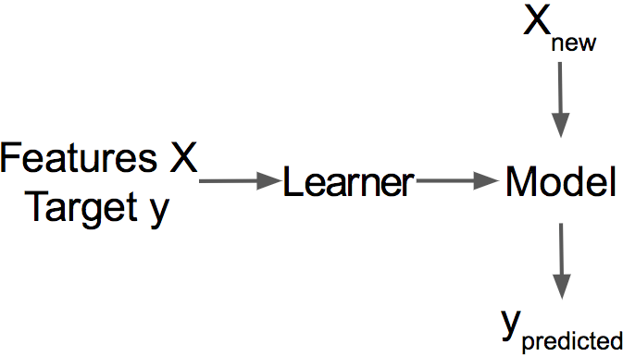
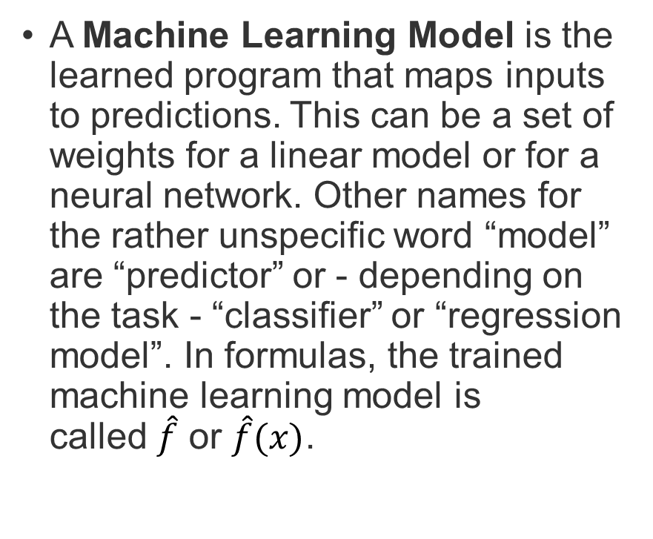
A Machine Learning Model is the learned program that maps inputs to predictions. This can be a set of weights for a linear model or for a neural network. Other names for the rather unspecific word “model” are “predictor” or - depending on the task - “classifier” or “regression model”. In formulas, the trained machine learning model is called $\hat{f}$ or $\hat{f}(x)$.

Slide 19
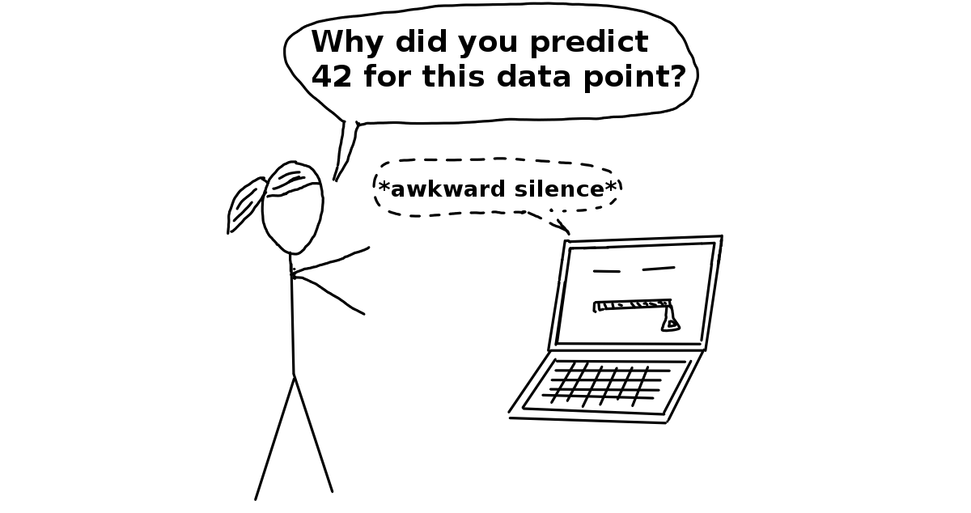
Black Box Model
A Black Box Model is a system that does not reveal its internal mechanisms. In machine learning, “black box” describes models that cannot be understood by looking at their parameters (e.g. a neural network). The opposite of a black box is sometimes referred to as White Box, and is referred to in this book as interpretable model. Model-agnostic methods for interpretability treat machine learning models as black boxes, even if they are not.

Slide 20
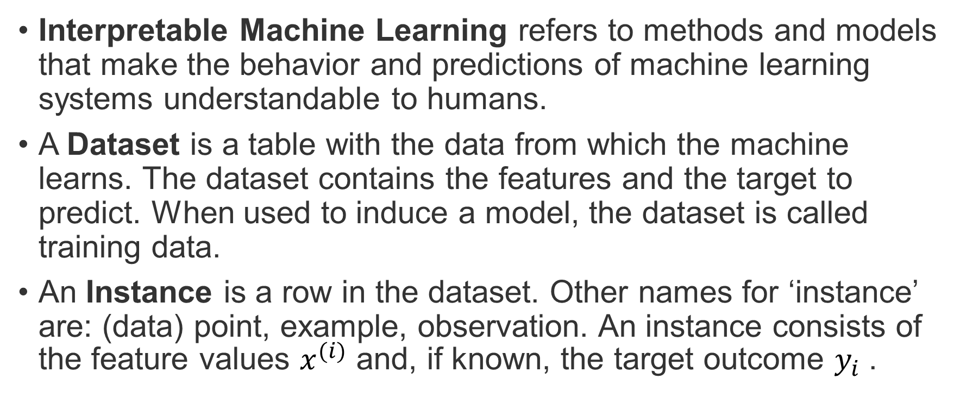
2.3 Terminology
Interpretable Machine Learning refers to methods and models that make the behavior and predictions of machine learning systems understandable to humans.
A Dataset is a table with the data from which the machine learns. The dataset contains the features and the target to predict. When used to induce a model, the dataset is called training data.
An Instance is a row in the dataset. Other names for ‘instance’ are: (data) point, example, observation. An instance consists of the feature values $x^{(i)}$ and, if known, the target outcome $y_{i}$ .

Slide 21
2.3 Terminology
Interpretable Machine Learning refers to methods and models that make the behavior and predictions of machine learning systems understandable to humans.
A Dataset is a table with the data from which the machine learns. The dataset contains the features and the target to predict. When used to induce a model, the dataset is called training data.
An Instance is a row in the dataset. Other names for ‘instance’ are: (data) point, example, observation. An instance consists of the feature values x(i)𝑥(𝑖) and, if known, the target outcome yi𝑦𝑖.
The Features are the inputs used for prediction or classification. A feature is a column in the dataset. Throughout the book, features are assumed to be interpretable, meaning it is easy to understand what they mean, like the temperature on a given day or the height of a person. The interpretability of the features is a big assumption. But if it is hard to understand the input features, it is even harder to understand what the model does. The matrix with all features is called X𝑋 and x(i)𝑥(𝑖) for a single instance. The vector of a single feature for all instances is xj𝑥𝑗 and the value for the feature j𝑗 and instance i𝑖 is x(i)j𝑥𝑗(𝑖).
The Target is the information the machine learns to predict. In mathematical formulas, the target is usually called y𝑦 or yi𝑦𝑖 for a single instance.
A Machine Learning Task is the combination of a dataset with features and a target. Depending on the type of the target, the task can be for example classification, regression, survival analysis, clustering, or outlier detection.
The Prediction is what the machine learning model “guesses” what the target value should be based on the given features. In this book, the model prediction is denoted by ^f(x(i))𝑓^(𝑥(𝑖)) or ^y𝑦^.

